Slide 1
Welcome to Fall 2023 Surplus Lines Law Group
Hosted by
Thank you to our sponsors

Slide 2
Anti-trust Admonition
This seminar is intended to inform participants about current developments in the law regarding surplus lines insurance and related topics. All persons affiliated with the insurance industry need to be mindful of the constraints of the antitrust laws. There shall be no discussions of agreements or concerted actions that may restrain competition. This prohibition includes the exchange of information concerning individual company rates, coverages, market practices, claims settlement practices, or any other competitive aspect of an individual company’s operation. Participants in this seminar shall not discuss the business interests of any individual insurer or others, including but not limited to, the plans of an insurer involving, or the possibility or desirability of:
Raising, lowering or stabilizing premiums or commissions;
Doing business or refusing to do business with particular, or classes of, insurers, reinsurers; agents, brokers or insureds; or
Acting in any way that would affect the availability of products or services in any market.

Slide 3
Agenda
7:00 a.m. Breakfast buffet/registration
8:00 a.m. Welcome and antitrust
8:05 a.m. AM Best/Stamping Office Premium Report
8:15 a.m. State updates
10:00 a.m. Break
10:15 a.m. Federal updates
10:30 a.m. Update on NAIC Privacy Protections Work Group
11:10 a.m. Market Conduct Investigations and Mallory v. Norfolk Southern
11:20 a.m. Property Insurance Market Update
11:30 a.m. Hot topics from audience
11:55 a.m. Spring 2024 & Future Meetings
12:00 p.m. Lunch Begins

Slide 4
2023 AM Best Report Highlights
$98.5 billion market
19% increase in 2022 surplus lines premium
183% increase since 2011
Higher ratings than standard P/C industry
No impairments in 19 years, with one unique exception
AM Best outlook is stable

Slide 5
Surplus Lines Premium Growth

Slide 6
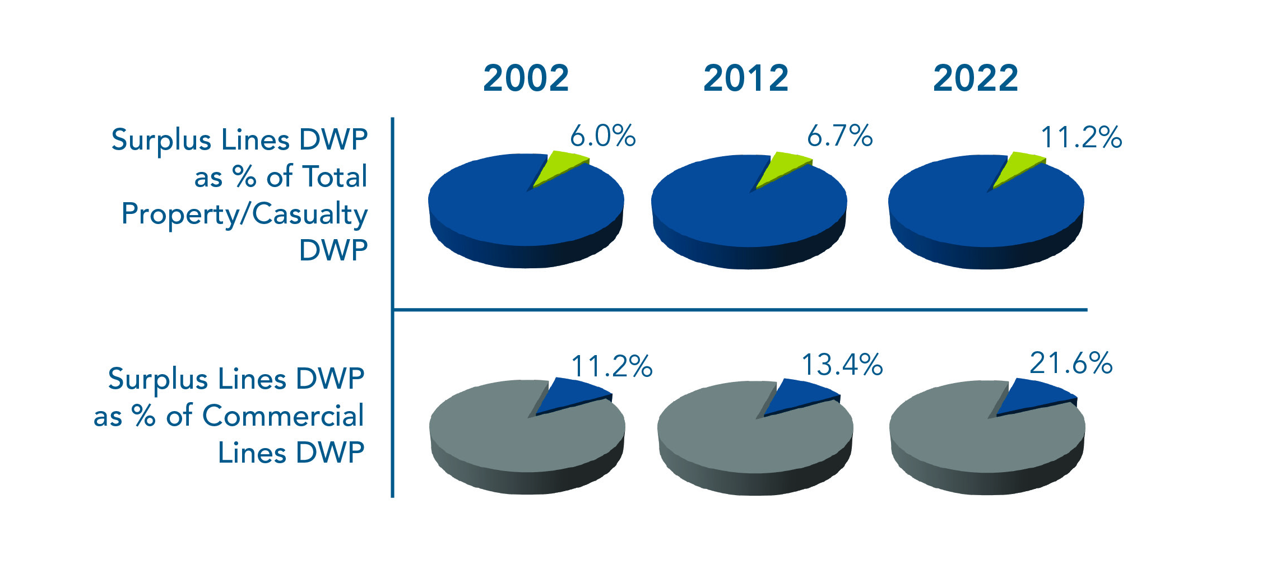
20-Year Growth

Slide 7
Best’s Rating Distribution

Slide 8
Stamping Office Premium Growth

Slide 9
State Updates
California David Kodama, The Surplus Line Association of California
Florida Mark Shealy, Florida Surplus Lines Service Office
Illinois David Ocasek, Surplus Line Association of Illinois
Louisiana Ronnie Johnson, McGlinchey Stafford
Nevada Maria Muzea, Nevada Surplus Lines Association
New York Howard Greene, Excess Line Association of New York
Texas Cheyenne Herrera, Surplus Lines Stamping Office of Texas
Additional States John Meetz, Wholesale & Specialty Insurance Association

Slide 10
Federal Updates
Gary Sullivan, American Property and Casualty Insurance Association
Keri Kish, Wholesale Specialty Insurance Association
Topics:
Autonomous vehicles
National Flood Insurance Program
SAFER Banking Act
Senate Banking hearing on property insurance
Third-party litigation finance
Wildfire Commission – Report to Congress

Slide 11
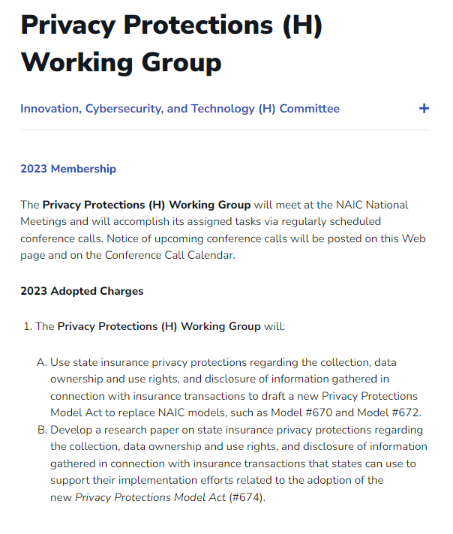
NAIC Consumer Privacy Protection Model Act
Privacy Protections (H) Working Group has been working on a draft of a Consumer Privacy Protection Model Act since late last year.
Ambitious timeline originally called for adoption before the end of 2023.
Expect additional revisions to be released ahead of the Fall National Meeting in Orlando.

Slide 12
SURPLUS LINES LAW GROUP
Data Privacy Issues Overview
Chicago, IL
October 20, 2023
Dan Brown
415-528-7329
DanRBrown@Eversheds-Sutherland.com

Slide 13
NAIC ISSUES (Privacy Protections (H) Working Group)
Very controversial draft [for good reason]
A lot pf pushback from industry and other state regulators (drafting driven by VA and CA)
Substantially more strict than CCPA, GDPR, or privacy law in any major jurisdiction
Supposed to have a draft to H Committee this year, but realized will not happen and asked for more time
Reevaluating the process and approach as a whole
The Chair (Katie Johnson – VA) expected to retire at year-end, so leadership change

Slide 14
Comparison of State Laws: Applicability

Slide 15
Key Exemptions

Slide 16
Consumer Rights (almost agreement)

Slide 17
Use of Sensitive Personal Information

Slide 19
Market conduct investigations
Michael Byrne, McDermott Will & Emery

Slide 20
Mallory v. Norfolk Southern
Michael Byrne, McDermott Will & Emery

Slide 21
Property Insurance Market Update
Fred Karlinsky, Greenberg Traurig, P.A.

Slide 47
Hot topics from the audience

Slide 48
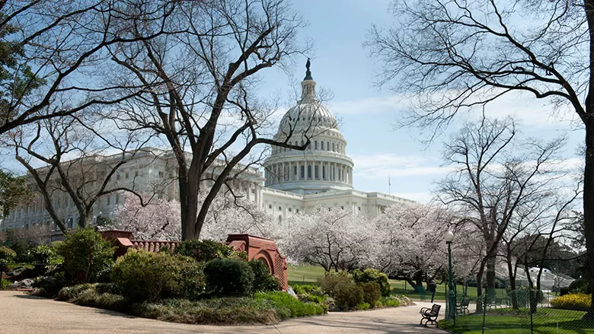
Save the Date for 2024 Spring Surplus Lines Law Group
April 18-19, 2024
Washington D.C.
Hyatt Regency Washington
on Capitol Hill

